Slide 1
Viscotech
Professor Burnes
Leeds School of Business
University of Colorado Boulder
Leeds
B U S I N E S S
Page 1

Slide 2
The Space in Which Viscotech Operates
Dominated by large players on both the Human and Animal Side
MANY competitors at the start up level
Need FDA Approval
Need Clinical Trials
Fundraising means SEC Filing or Exemption

Slide 3
Viscotech is an early stage, small player in a crowded market with competitive funding
ANIMAL NUTRITION
Archer Daniels Midland
Market Cap $22.6B
Revenue: $86B
Start Ups: 43,306
Deals: 52,090
CHICAGO VC SPACE
~480 Investors, with ~1,120 Funds
$100M Median AUM
HUMAN NUTRITION
Pfizer
Market Cap $149B
Revenue: $64B
Start Ups: 42,306
Deals: 51,121
Equipment: 2,947
Deals: 3,784

Slide 4
Viscotech KPIs
Clinical Trials
FDA Approval
Outcomes
PreSales – contacts, contracts

Slide 5
The Viscotech Funding and Operational Journey

Slide 6
What is the Problem the Founders are trying to Solve – What is the Business Case for this Problem?

Slide 7
Org Chart – Part 1
Board/Founders
Dr. Samuel Evans
Louis Brown
Dr Harold Stein
Melvin O’Connor
Ken Jones, CEO
Accntg/Law
Melvin O’Connor
Leonard Atkins
Paul Benjamin

Slide 8
Org Chart, Part 2
Board
Ken Jones, CEO
Legal
Finance
Fredericks Communication
Production
Sales
Service
Engineering

Slide 9
Does the Share Price Make Sense?
Implied Company Value
PRE REVENUE?
PRE FDA APPROVAL?

Slide 10
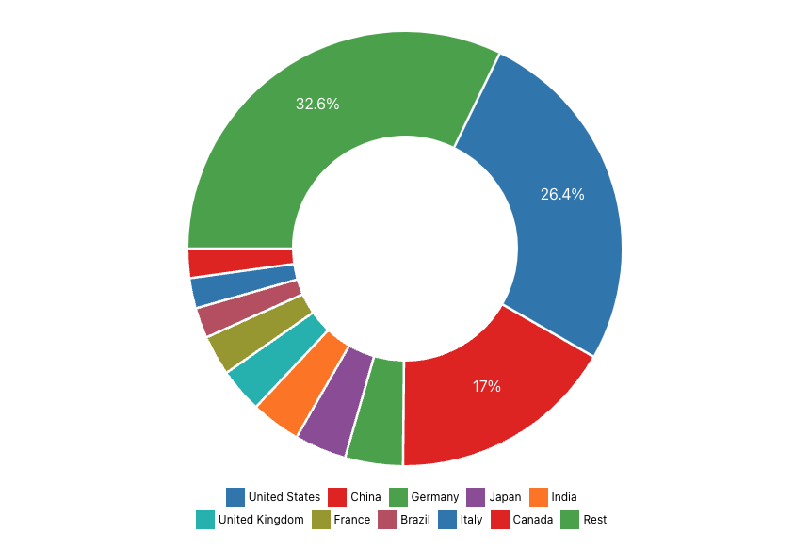
Share of Global GDP by Country/Region ? Do their growth targets make sense?
Source: GDP World

Slide 11
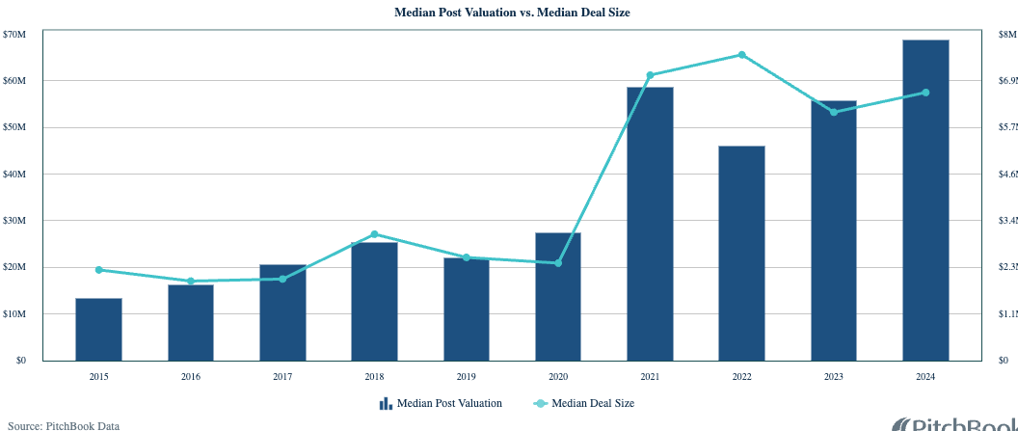
Diagnostics and Life Sciences

Slide 12
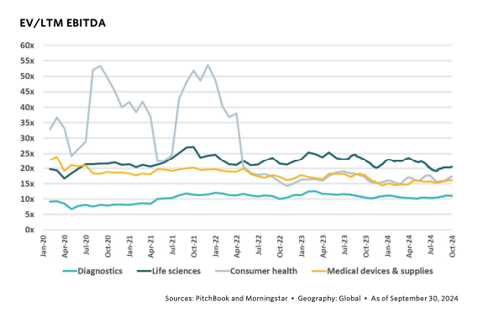
Diagnostics/Life Sciences Multiples

Slide 13
Financials
? Do Their Pro Formas Make Sense based on Case Assumptions?

Slide 14
I looked at 3 cases
Base Case: They sold into all of their goal markets
Case 2: No Human Markets
Case 3: No Human Markets, No US Animal Markets
And THEN, I looked at sensitivity analyses based on EBITDA and Various Multipliers
Then, I looked at cost of capital scenarios on top of that

Slide 15
Pre Money/Post Money

Slide 16
Valuation Sensitivity to EBITDA and multiple
Case Base Case is 5x multiple, or $68.2M

Slide 17
The point is…
They set valuation “arbitrarily” – and it is inconsistent on an offer price, multiples, and valuation dilution
This does not make sense.

Slide 18
Indications of Conflict/Red/Yellow Flag
MIFT
No Reg A
Was Atkins the right person?
O’Connor on board and doing financials
O’Connor on board and writing offerings docs
Raising funds to backpay themselves - Brown and Stein hired at $1500/month as “consultants”
Raising funds to reduce bank indebtedness (that they took on to pay themselves)
They own part of Fredericks – the Communications firm

Slide 19
Scorecard
Team, low qualification
Clear Value Proposition, low
Product Market Fit?: Can’t tell (negative)
Use of Capital: paying debt and their past salaries
Need Additional Capital: High (negative)
Conflicts of Interest: Accountant/Lawyer, Comms Group – High (negative)
Risk: SEC non-compliance; pre revenue; pre Approval; low experience in animal sector

Slide 20
Recommendation
What do you do if you are Ken Jones?

Slide 21
Take Aways
Know the business case for your venture
Your Accountant and Attorney cannot be on the Board
Before you raise money, engage a Securities Lawyer
Valuations need to be consistent
Not recommended to raise money to pay yourselves for past services

